Slide 1
MADHAV INSTITUE OF TECHNOLOGY AND SCIENCE, GWALIOR
TECHNICAL ENGLISH 100017
Mini Skill Based Project
Presentation
TOPIC
Juveniles should be sentenced as Adults
PRESENTED BY – ASMITA JAIN
EO201017

Slide 2
WHO IS JUVENILE?
A CHILD WHO HAS NOT ATTAINED A CERTAIN AGE AT WHICH HE CAN BE HELD LIABLE FOR HIS CRIMINAL ACTS LIKE AN ADULT PERSON UNDER THE LAW OF THE COUNTRY.
THIS AGE AT INDIA IS SET AT 18.
WHAT IS JUVENILE DELINQUENCY?
THE ANTI SOCIAL OR CRIMINAL ACTIVITY OF THE CHILD WHICH VIOLATES THE LAW.

Slide 3
WHEN DOES JUVENILES COMMITS A CRIME? WHAT ARE THE CAUSES?
JUVENILE DELINQUINCY
NEGATIVE INFLUENCES
LACK OF PARANTEL GUIDANCE
PYSCHIATRIC ILLNESS
PEER PRESSURE
MEDIA EXPOSURE
INSECURITY
LOVE OF ADVENTURE

Slide 4
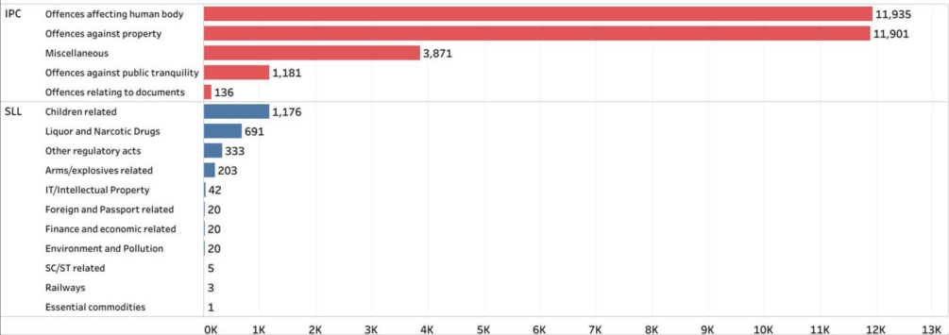
STATS
AS PER 2018, NCRB, CRIME IN INDIA REPORT, 99% OF JUVENILES APPREHANDED OF CRIMES ARE BOYS.
TYPES OF OFFENCES DONE BY JUVENILES –

Slide 5
CURRENT POLICIES AND METHODS
In India, the problem of juvenile delinquency is tackled on based of following fundamental principles:
Young offenders should not be tried; they should rather be corrected;
They should not be punished but reformed
Exclusion of delinquents i.e. children in conflict with the law from the ambit of Court and stress on their non-penal treatment through community-based social control agencies.

Slide 6
THE LAW
PUNISHED AS JUVENILES UNDER DIFFERENT LAW AND COURT
INVOLVED IN HEINOUS OFFENCES
UNDER 18
AGE 16 -18 SENTENCED AS ADULTS
JUVENILE DELINQUENCY LAW, JUVENILE JUSTICE ACT, 2000 AMENDMENT- 2015

Slide 7
LOOPHOLES
UNDER SECTION 27 OF CrPc, ANYONE UNDER THE AGE OF 16 IS NOT SENTENCED TO DEATH OR LIFE IMPRISONMENT IRRESPECTIVE OF THE CRIME THEY COMMITED.
UNDER SECTION 16 OF CrPc, FOR HEINOUS OFFENCE COMMITED BY A 16+, JUVENILE JUSTICE BOARD ENQUIRES ON THE BASIS OF PHYSICAL AND MENTAL STATE OF CHILD – WHETHER TO DISPOSE OFF THE CASE OR START A TRIAL.
THIS PROCEDURE IS ARBITARY AND IRRATIONAL.

Slide 8
CASE STUDY
IN DELHI, A 16 YR OLD BOY WHO RAN HIS FATHER’S CAR OVER A 32 YEAR OLD MAN.
THIS WAS A CASE OF “HOMICIDE” AND NOT MURDER.
THIS HAS NO MINIMUM SENTENCE, THEREFORE HE WAS TRIED AS A CHILD AND NOT ADULT.
ONLY 3 CATEGORIES WERE CONSIDERED FOR CRIMES COMMITTED BY MINORS -
PETTY – UPTO 3 YEARS
SERIOUS – UPTO 7 YEARS
HEINOUS - 7 YEARS AND ABOVE

Slide 9
CONCLUSION
ALTHOUGH THE CRIME RATE BY JUVENILES HAS COME DOWN AFTER THE 2015 AMENDMENT, THERE ARE STILL SOME MAJOR LOOPHOLES.
FOR CRIME THAT ARE NOT ‘CATEGORISED’ AS HEINOUS BUT ARE STILL INTENSELY CRUEL IN NATURE, THE PUNISHMENT IS NOT ENOUGH.
ALSO THE JUVENILES CANNOT BE METED OUT A CAPITAL PUNISMENT OR A LIFE IMPRISONMENT SENTENCE, REGARDLESS OF THE SERIOUSNESS OF THE CRIME.
THEREFORE, TRIAL SHOULD BE DONE ON THE BASIS OF CRIME COMMITTED AND NOT ON THEIR AGE.

Slide 10
THANKYOU
WOULD LIKE TO HEAR YOUR SUGGESTIONS -

